Slide 1
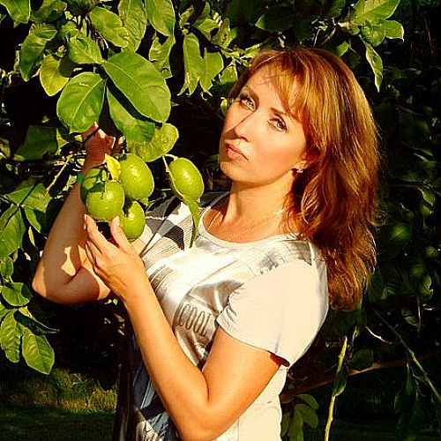
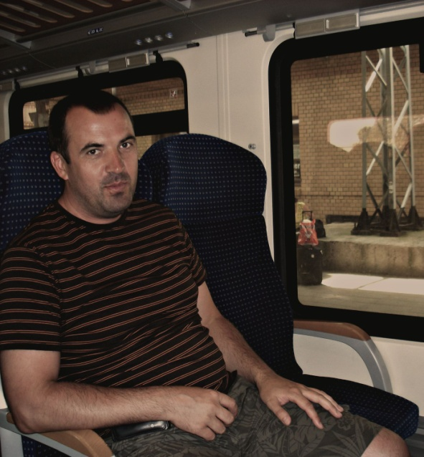
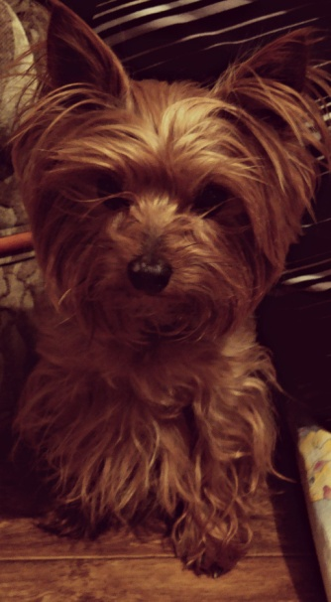
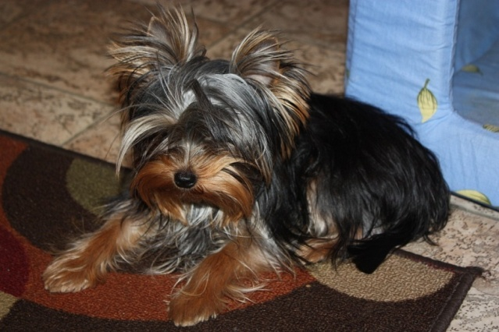
My name is Yana. My surname is Surikova. I’m a girl of 15 years. I was born on 26 of Mar4ch in 1997 in Tver, but when I was two my family moved to Saint-Petersburg.
My father is a businessman, my mother is an accountant. I have two dogs: Danya and Nika. I love my family very much.

Slide 2
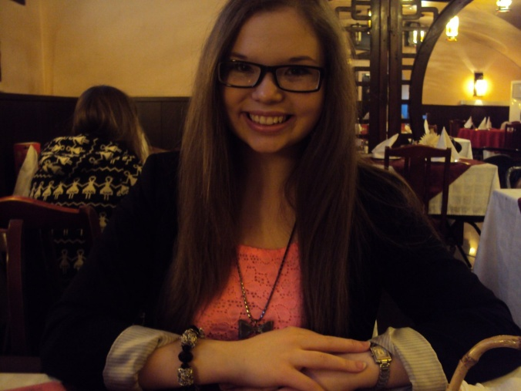
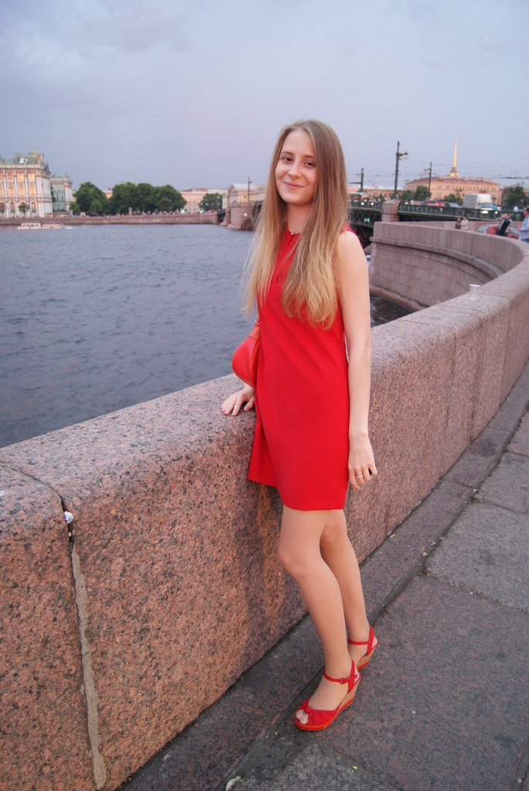
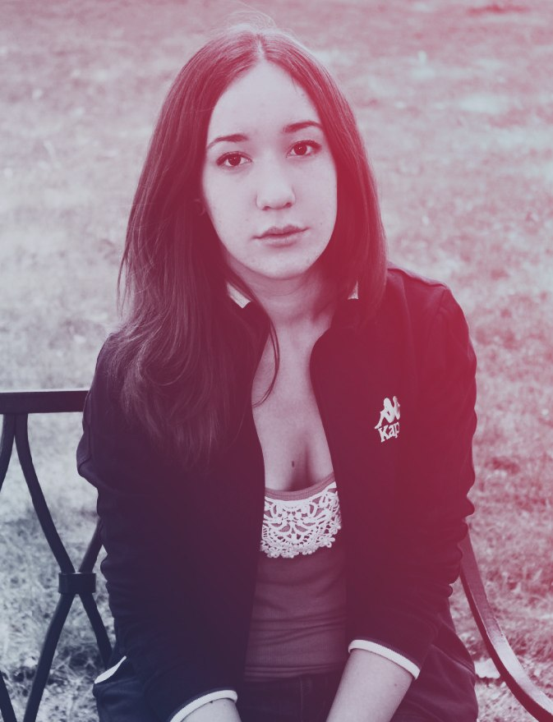
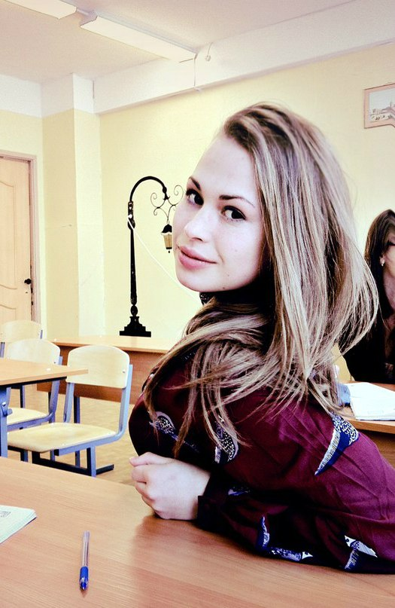
I have a lot of friends, but I have the only best friend. Her name is Katya. We got acquainted in the english summer camp. We have much in common. I love her so much.

Slide 3
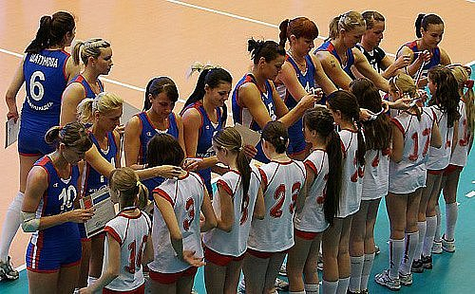
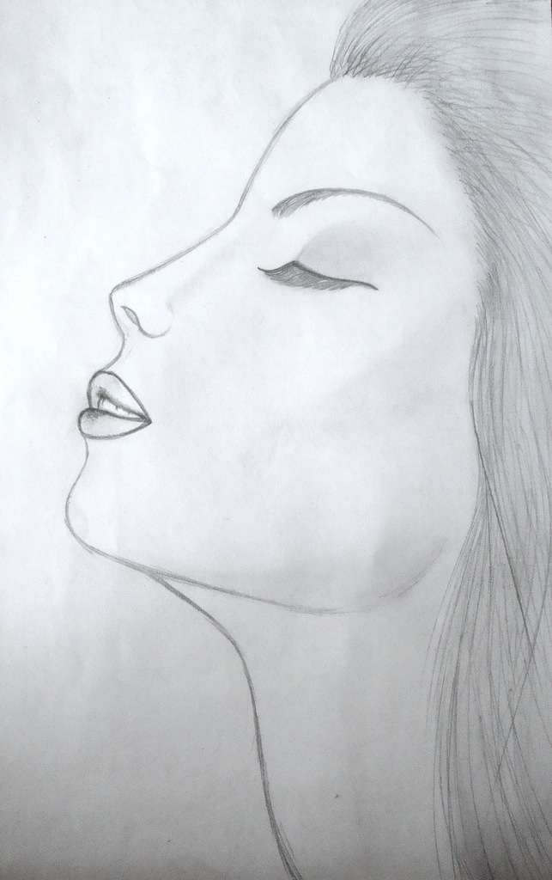
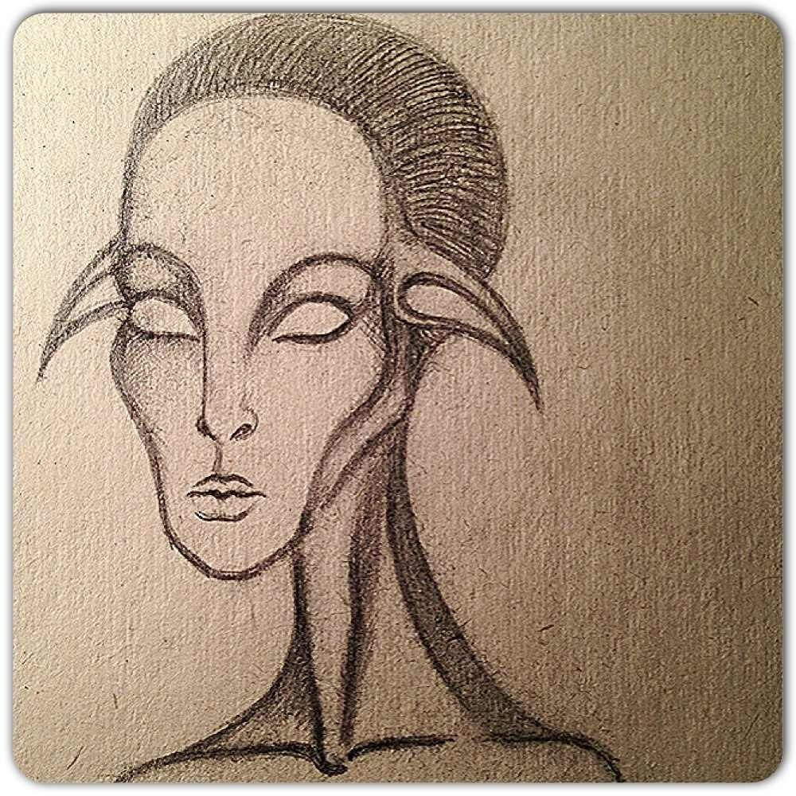
Мy hobby is playing volleyball, but in my freetime I like to draw and compose poems.

Slide 4
Mutual understanding is the main thing in my family. We often go for a walk together, but sometimes we go to the cinemas, theatres and other places. We always celebrate holidays together like birthdays, the New Year, Mothers day and so on.
In future I would like to have a big family with nice children and a loving husband. It’s the main thing in my life.

